Slide 1
Note-taking in APEX
Pinellas Gulf Coast Academy

Slide 2
Choose your method of note-taking
Microsoft Class Notebook
Log in to www.clever.com
Log in as student
Search for school and enter your school login info (R2D2 and password)
Open Office 365 app
Open One Note
Open Notebook titled (your name) @ Pinellas County Schools
Pen and Paper
Ask your teacher for a spiral notebook to take your notes in and pencil
(you are responsible for keeping up with your notebook)

Slide 3
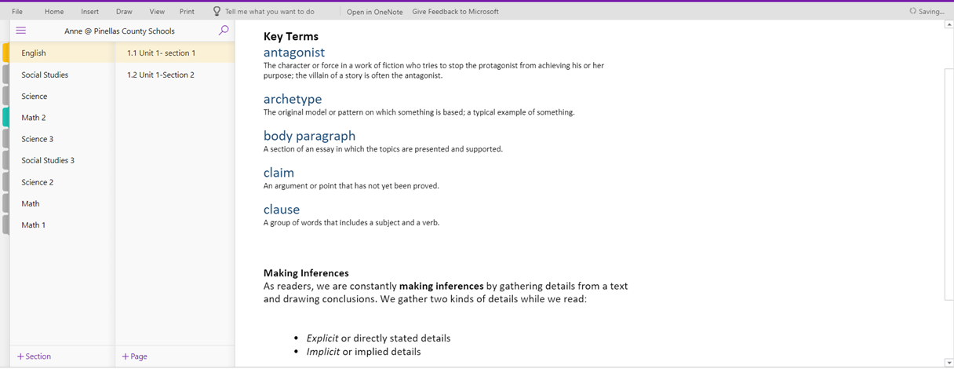
Sample One Note Notebook
You can add as many sections as you need.
You can add as many pages to each section as you want.

Slide 4
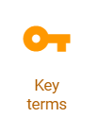
Note-taking in English
Read EVERYTHING (listen with audio if you’d like!).
Click on the key terms icon and write down ALL key terms and definitions.
Copy down information in menus and text boxes. This information is VERY important.
DON’T skip over the activities- these help you understand and practice what you are learning.
Summarize historical background information for the stories and essays in your notes and any information that is significant to why the author wrote the story or how it relates to other literature, art, or major works.
ALWAYS click on the Reading Materials icon. This contains your reading selections for the section. For easy reference, you can copy and paste these selections into your Notebook.

Slide 5
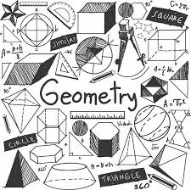
Note-taking in Math
Notebooks should include:
A date
A Unit and Section number (ex. 2.2.1) and Title (ex. Algorithms)
Key terms and definitions
Formulas
Steps for solving the problem
Anything written on the white board during direct instruction

Slide 6
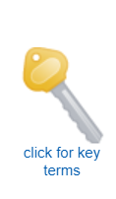
Note-taking in Science
APEX Study Sheet/Guides
The Science department has copies of study sheet/guides for students who use paper and pen.
Students may also complete study sheet/guides online using their One Note notebooks and Mrs. Gicka or Mr. Mitchell will help students set those up online.
Some considerations when taking notes:
Write down ALL key terms and information in bold
Pay careful attention to text boxes, charts, and graphs
Answer each part of the study sheet question, as some questions have two questions in one.

Slide 7
Note-taking in Social Studies
APEX Study Guides
Study guides are utilized in Social Studies classes, and teachers have online class notebooks they can digitally share with students containing study guides that students can copy and paste directly into their One Note Notebook. Please see Mr. Klaskow or Mr. VanRiper for assistance in setting up your online notebook for each Social Studies class.
Considerations when completing study guides:
Write down all key terms and definitions.
Pay careful attention to timelines, charts, and textboxes.
Answer each part of the question on the study guide. Some questions have two questions in one!

